Slide 1

A PROPOSAL OF SMART AUTOMATION SYSTEM
Mini project 2022
Team Id- 22_IOT_2A_03

Slide 2
SMART HOME AUTOMATION SYSTEM
Team Id- 22_IOT_2A_03
S No | Full Name | Roll No | Branch & Section
1. | Devashish Mishra | 2101641550035 | CS-IoT-2(A)
2. | Harsh Verma | 2101641550041 | CS-IoT-2(A)
3. | Anuj Agnihotri | 2101641550021 | CS-IoT-2(A)
4. | Adarsh Nigam | 2101641550010 | CS-IoT-2(A)
5. | Bhavi katiyar | 2101641550032 | CS-IoT-2(A)

Slide 3
Objective-
To make life easy
01

Slide 4
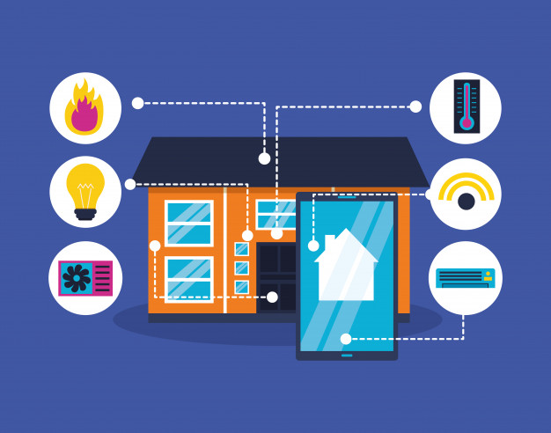
About project-
The last decade has seen fast improvement in the field of automation.
The main idea here is to build a smart home device which can be
used to control the home appliances such as lights, fans, room heaters,
television, dish washer, etc. via Bluetooth.
Team ID- 22_IOT_2A_03
02
This Photo by Unknown Author is licensed under CC BY

Slide 5
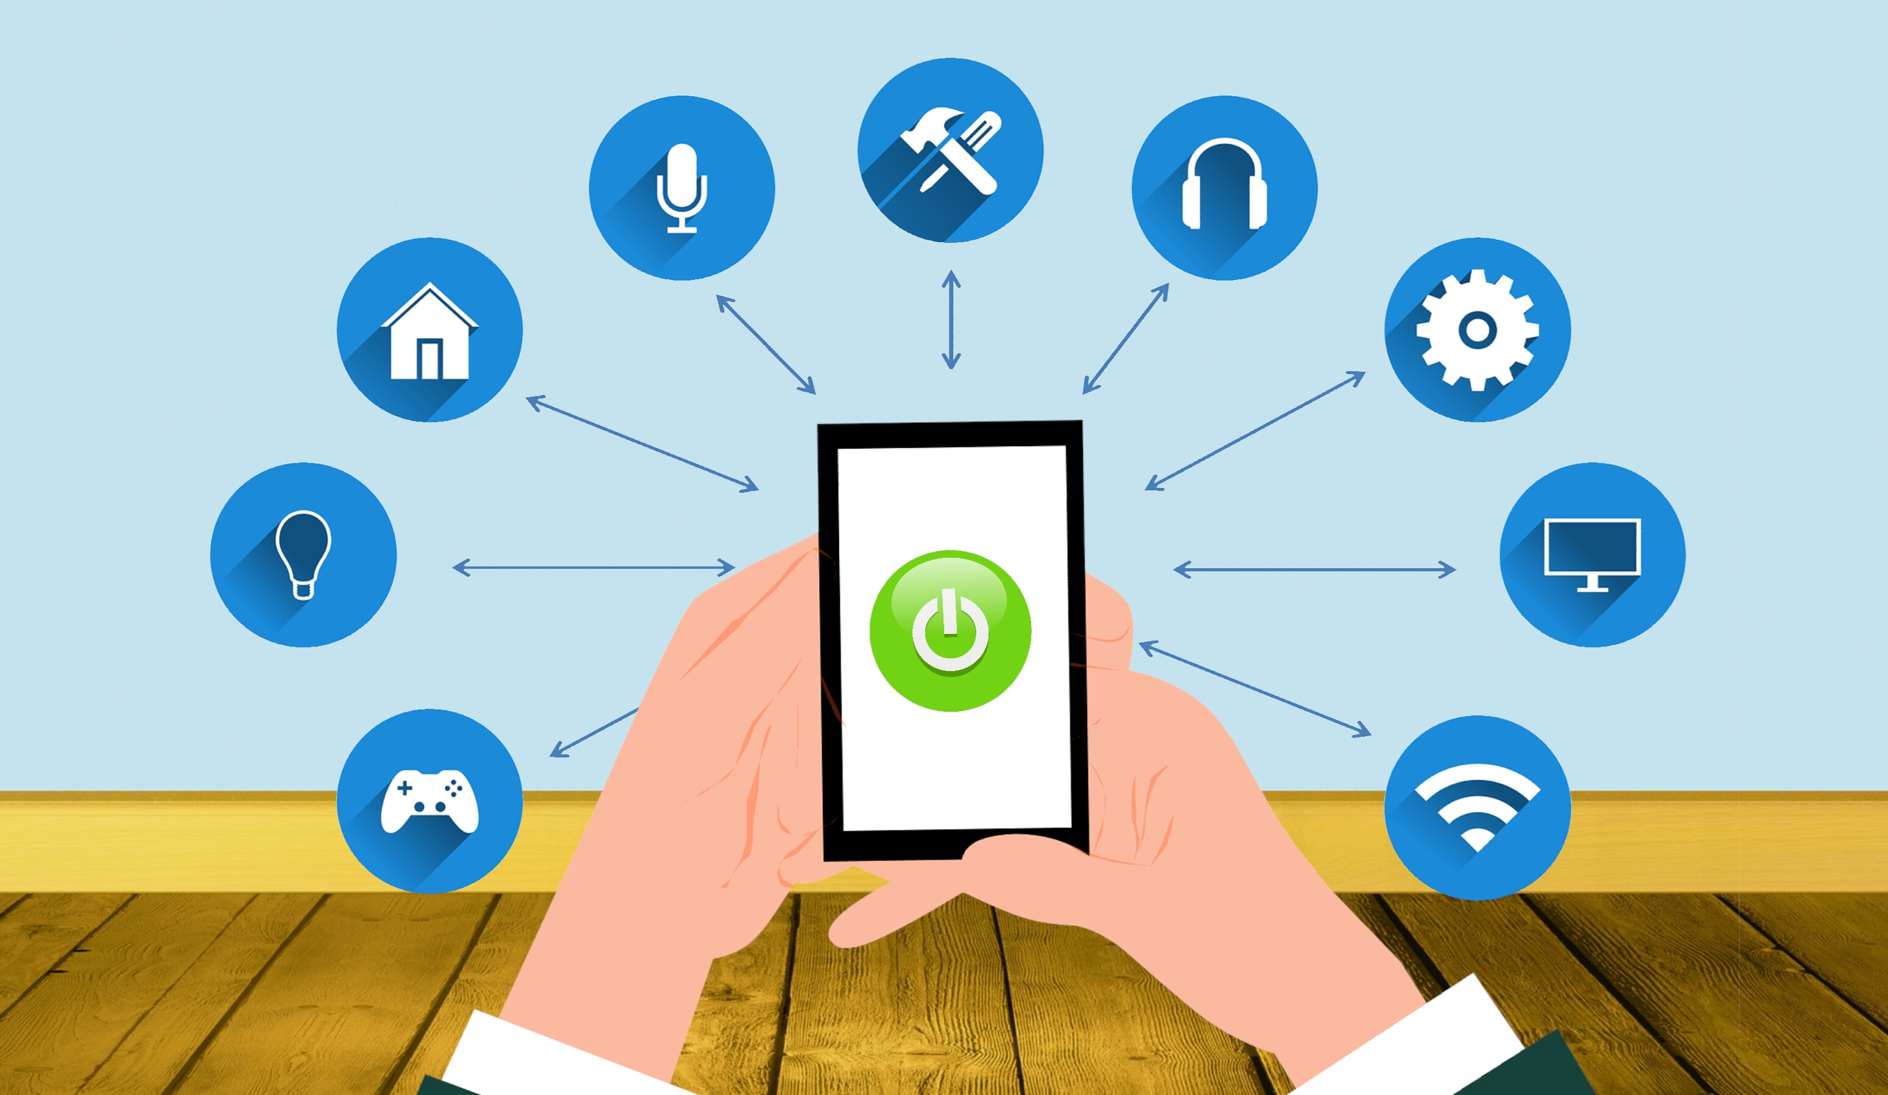
Smart lighting is an integrated system that involves segments such as light
sources, luminaries, sensors & control units, connectivity, and analytics.
Implementation involves combining these elements that offer lighting solutions
that can be monitored, controlled and automated using a centralized system.
Team ID- 22_IOT_2A_03
03

Slide 6
3. Feasibility Study-
i). Analysis-
smart home system composed of multiple devices that are hereby referred to as “nodes” that are independently connected to a cloud based server, hereby referred to as “dashboard”. For the software part, the node is connected to the server and exchanges data using the MQTT protocol (Message Queuing Telemetry Transport) which is a protocol that is based on the TCP/IP protocol stack and uses the subscribe/publish method. The dashboard will be implemented using C++ (HomeAssistant.io) and will include a simple login form to a simple member area where we will have a pairing function that pairs a particular device with a particular user. This will allow the user to monitor and control his or her house from any computer or mobile phone remotely.
Team ID- 22_IOT_2A_03
04

Slide 7
ii). Technical Feasibility-
a. Power Consumption-
The ESP8266 uses between 2.5V and 3.6V. But the recommended maximum for
the input voltage is 3.3V. Most of the sensors run on 3.3V as well but in case we
use 5V sensors, we will then need to add a voltage regulator. When implementing
a sleep-mode, it could last for days, or even months without charging.
Team ID- 22_IOT_2A_03
05

Slide 8
b. communication capacity-
The ESP8266 uses standard Wi-Fi capabilities (802.11 b/g/n/e/i) with security
capabilities of WPA/WPA2 and encryption capabilities of WEP/TKIP/AES.
The ESP uses AT commands in order to be communicated to or from using serial (TX/RX).
c. Economic Feasibility-
The ESP8266 boards cost 2.46 USD at minimum, and 8 USD in Morocco.
The cheapest device or node that could be manufactured will cost no more than
20 USD (all included). The expected budget spent for this project is around 20-30 USD.
Team ID- 22_IOT_2A_03
06

Slide 9
d. Legal Feasibility-
All software and hardware used in this project are Open Source, some are under
GPL License. Codes used are all taken from public Github repositories and open
source solutions.
e. Operational Feasibility-
Some nodes may not be implemented within the final prototype manufacturing
process for operational issues. For example, the keypad door locking system needs
an actual door and a mechanical lock. The keypad is connected to an ESP8266 board
that controls a stepper motor that turns the lock.
Team ID- 22_IOT_2A_03
07

Slide 10
4.Methodology/ Planning of work-
Internet of Things comprises of a collection of sensors and actuators which gathers
the data from the environment. The data gathered can be further processed to generate information. This system allows the users to remotely control the appliances in their
absentia at the home. IoT based Home Automation system was implemented.
The Main components of the system are Node MCU(ESP8266), Relay Board.
Many sensors and equipments are used to monitor or supervise the home appliance.
Team ID- 22_IOT_2A_03
08

Slide 11
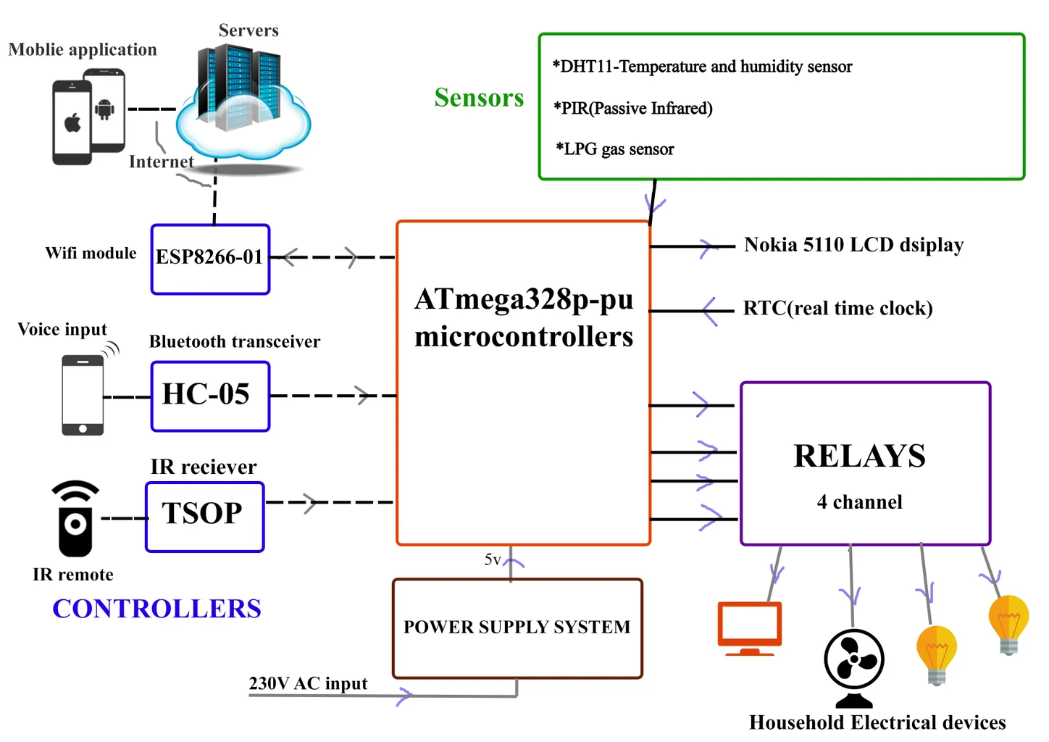
Figure.1: Architecture of Home Automation
09
Team ID- 22_IOT_2A_03

Slide 12
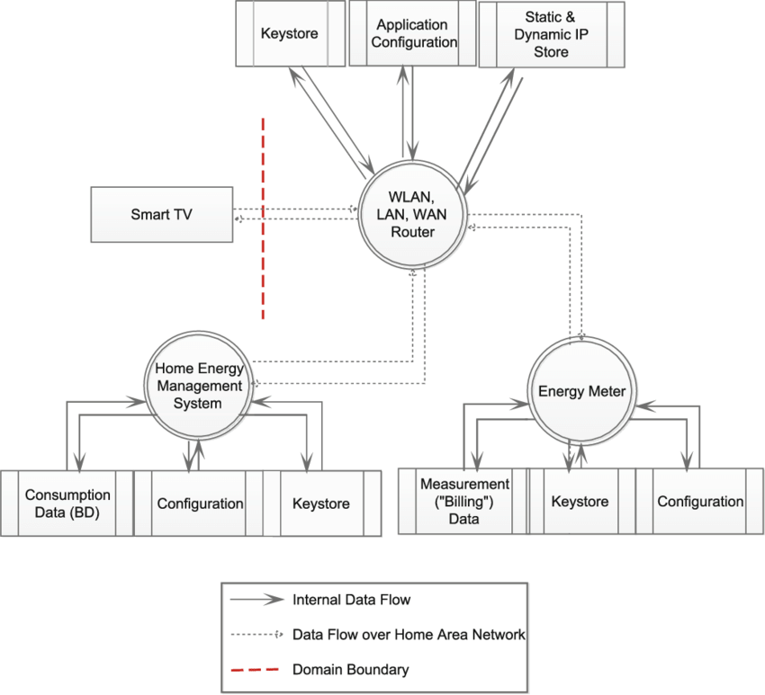
Figure.2: DFD Diagram
Team ID- 22_IOT_2A_03
10

Slide 13
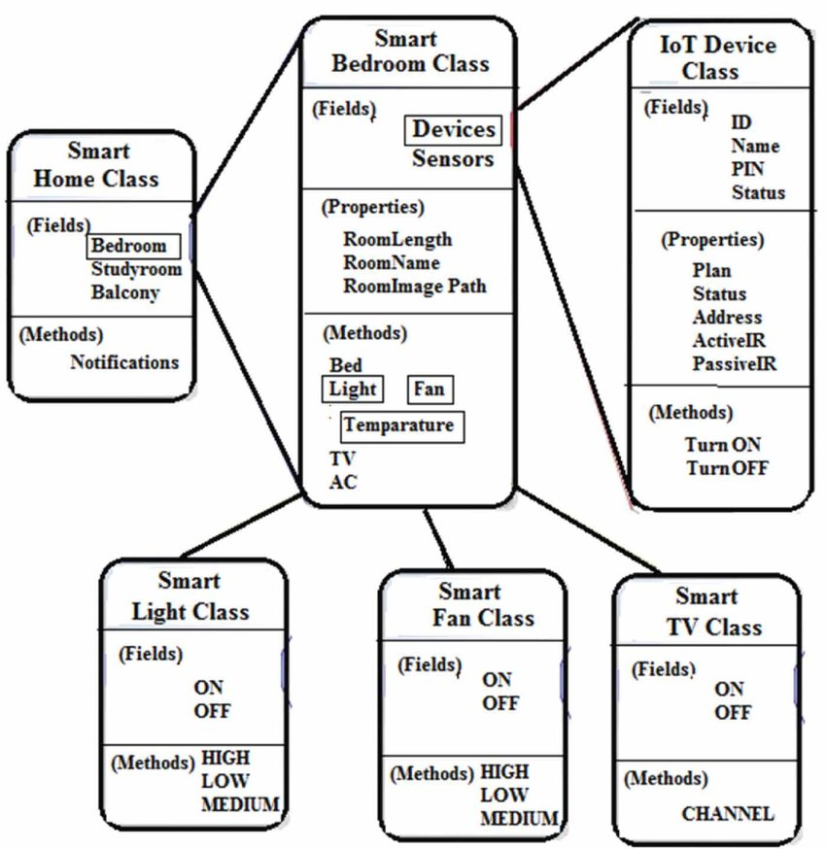
Figure.4: Class Diagram
Team ID- 22_IOT_2A_03
11

Slide 14
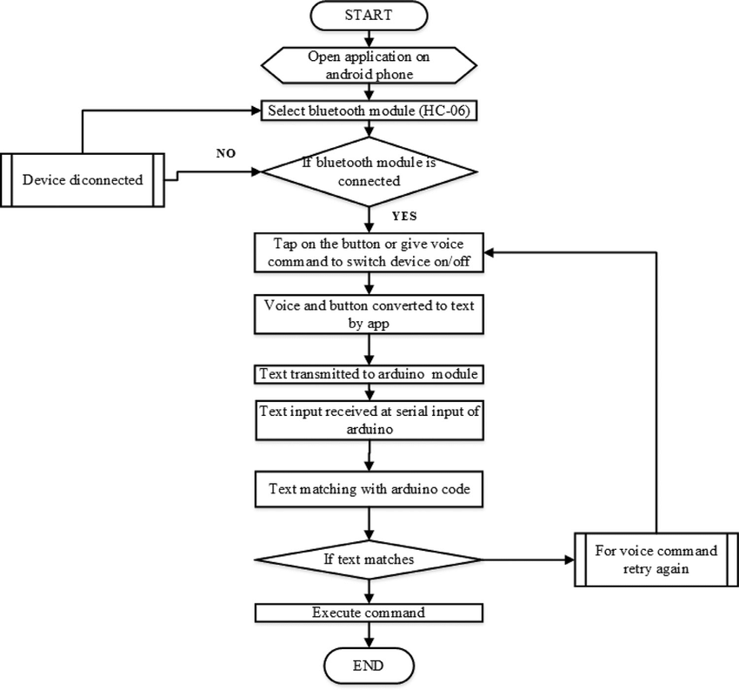
Figure.5: Flow Chart of Home Automation
12
Team ID- 22_IOT_2A_03

Slide 15
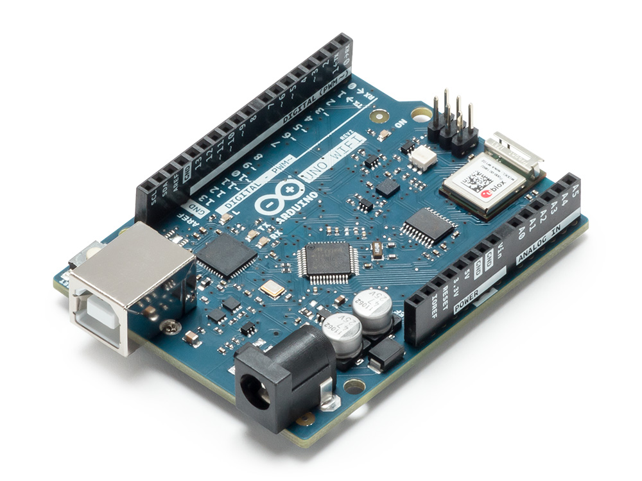
Tools/Technology used -
Hardware Requirements -
1) Node MCU
2) Bread Board
3) jumper wire
4) Relay board 5-v
5) Bulb
6) Holders
7) Plug
Team ID- 22_IOT_2A_03
13

Slide 16
Software Requirements-
1) Arduino IDE
2) Sinric Pro
Introduction of Components -
1). Node MCU -
The NodeMCU (Node MicroController Unit) is an open source software and hardware development environment that is built around a very inexpensive System-on-a-Chip (SoC) called the ESP8266. The Wifi Module Node MCU (ESP8266) will Receive commands from the
smartphone wirelessly through the internet.
Team ID- 22_IOT_2A_03
14

Slide 17
2).Relay board 5v- Relay boards are computer boards with
an array of relays and switches. They have input and output terminals and are designed to control the voltage supply. Relay boards provide independently programmable, real-time control for each of several onboard relay channels.
3).jumper wire - Jumper wires are simply wires that have connector pins at each end, allowing them to be used to connect two points to each other without soldering.
4).Bread Board- A breadboard (sometimes called a plugblock) is used for building temporary circuits. It allows you to place components and connections on the board to make circuits without soldering
Team ID- 22_IOT_2A_03
15

Slide 18
References-
1). Bouali, K. (2017, January 30). Specifications [Scholarly project]. Retrieved March 2, 2017.Bouali, K. (2017, February 3). BrainyHAB - Feasibility Study [Scholarly project]. Retrieved March 2, 2017.
2). Z. (n.d.). STEEPLE Definition | Marketing Dictionary. Retrieved February 25, 2017,from http://www.mbaskool.com/business-concepts/marketing-and-strategy-terms/6814-steeple.html
(2016, July 15).
3). Espressif Systems Instruction Set [E-Book]. Retrieved April 2, 2017. MQTT Essentials Part 3: Client, Broker and Connection Establishment. (2015, December 20).
4). Retrieved April 22, 2017, from http://www.hivemq.com/blog/mqtt-essentials-part-3- clientbroker-connection-establishment
Team ID- 22_IOT_2A_03
16

Slide 19
5). Mosquitto. (n.d.). Retrieved April 22, 2017, from http://www.mosquitto.org/ Z. (n.d.). STEEPLE Definition | Marketing Dictionary. Retrieved February 25, 2017, from http://www.mbaskool.com/business-concepts/marketing-and-strategy-terms/6814-steeple.html https://home-assistant.io/developers/architecture/
Team ID- 22_IOT_2A_03
17

Slide 20
THANK YOU….

